Slide 1
Data Structures
ICT-1211
Information and Communication Technology
Lecture-09
Date:

Slide 2
Arrays, Records and Pointers

Slide 3
Linear Arrays/ One Dimensional Array
In general, the length or the number of data elements of the array can be obtained from the index set by the formula.
Length=UB-LB+1
where UB is the largest index, called the upper bound, and LB is the smallest index, called the lower bound of the array.
Using the base address of a array LA, the computer calculates the address of any element of LA by the following formula:
LOC(LA[K])=Base(LA)+w(K-lower bound)
w-is the number of words per memory cell for the array LA.

Slide 4
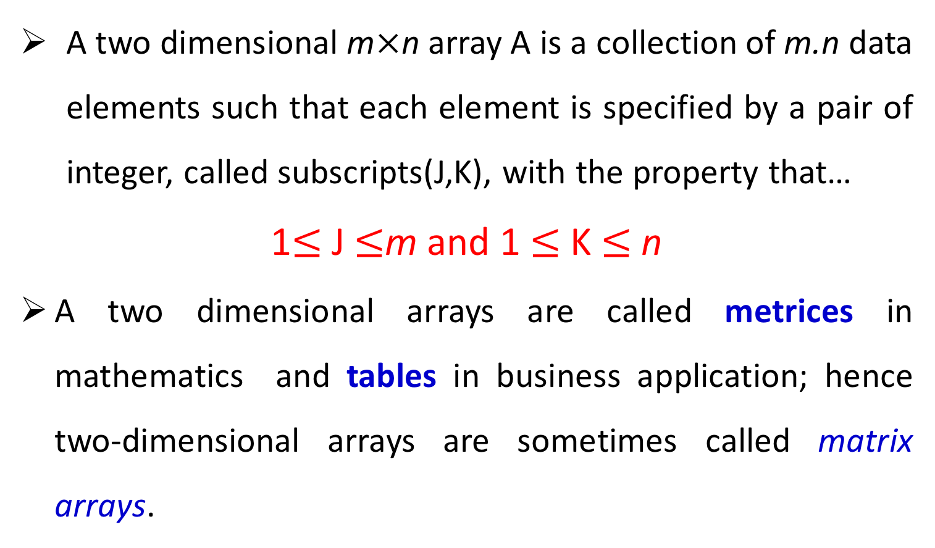
Two Dimensional Array
A two dimensional m$×$n array A is a collection of m.n data elements such that each element is specified by a pair of integer, called subscripts(J,K), with the property that…
1$≤$ J $≤$m and 1 $≤$K $≤$n
A two dimensional arrays are called metrices in mathematics and tables in business application; hence two-dimensional arrays are sometimes called matrix arrays.

Slide 5
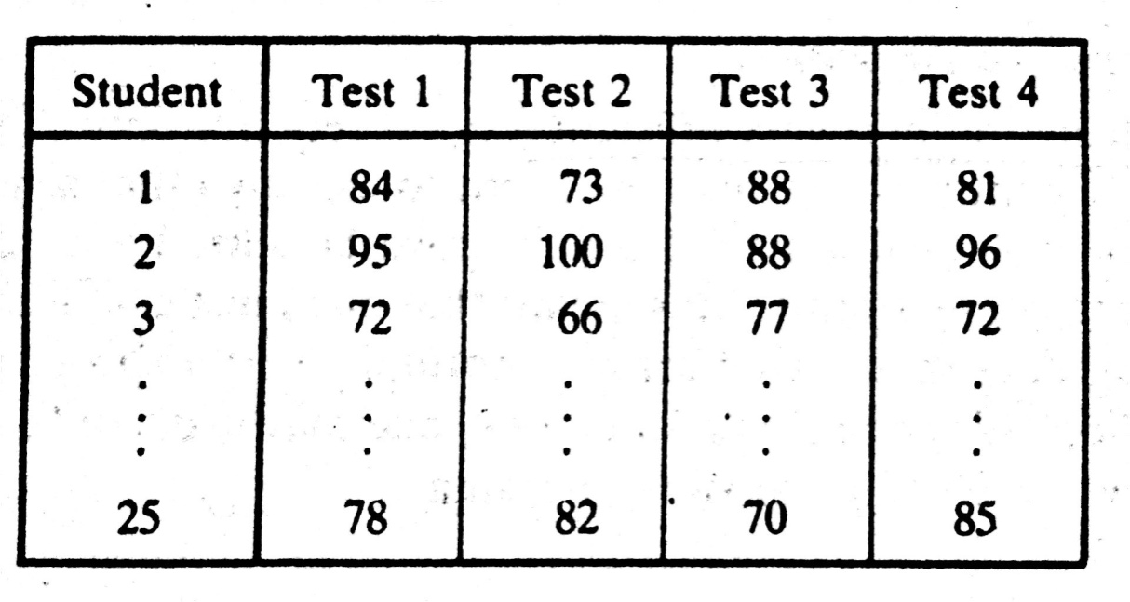

Two Dimensional Array: Representation in Memory
Let A be a two-dimensional array m$×$n array.
Although A is pictured as a rectangular array of elements with m rows and n columns,
The array will be represented by a block of m.n sequential memory location.

Slide 6
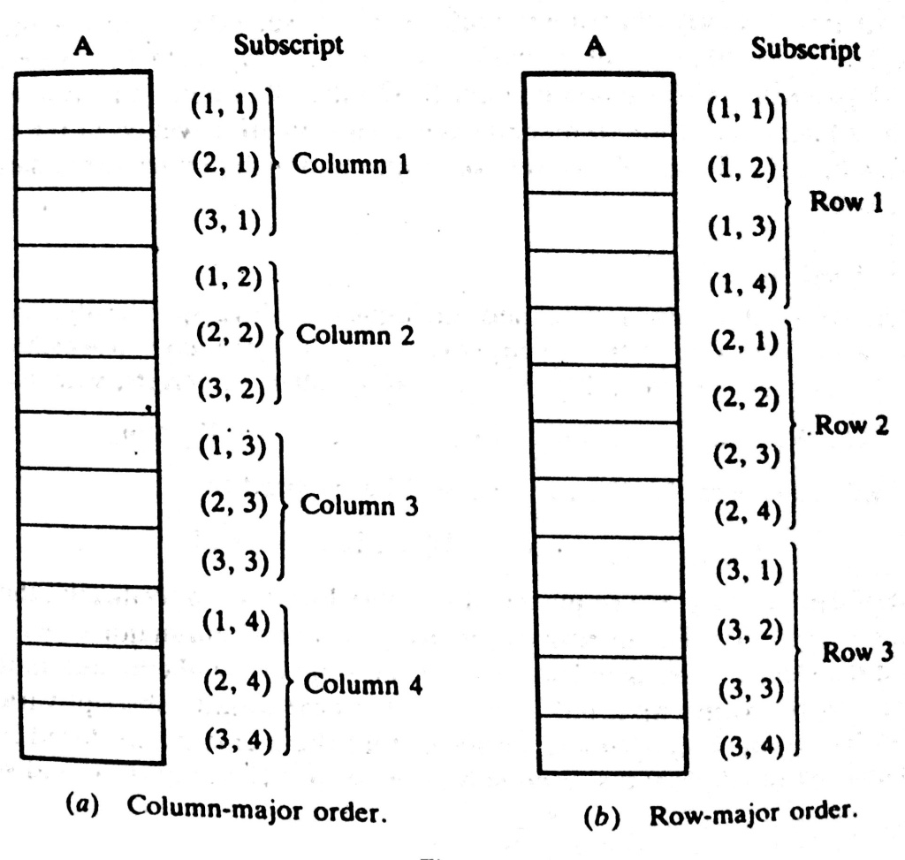
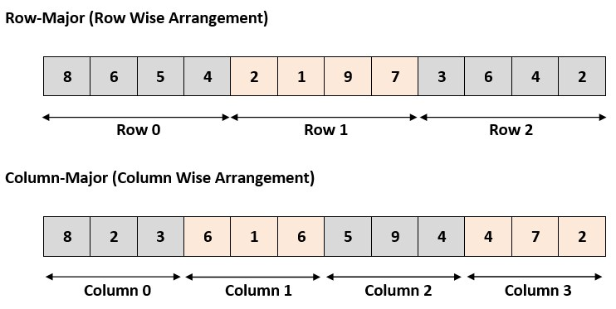
Two Dimensional Array: Representation in Memory
The programming language will store the array A either
      Column by Column – called Column Major Order (CMO)
      Row by Row-called Row Major Order(RMO)

Slide 7
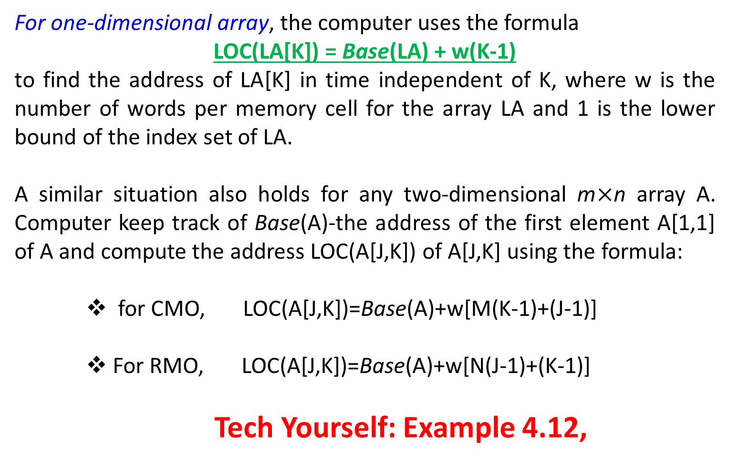
Two Dimensional Array: Accessing Element
For one-dimensional array, the computer uses the formula
LOC(LA[K]) = Base(LA) + w(K-1)
to find the address of LA[K] in time independent of K, where w is the number of words per memory cell for the array LA and 1 is the lower bound of the index set of LA.
A similar situation also holds for any two-dimensional m$×$n array A. Computer keep track of Base(A)-the address of the first element A[1,1] of A and compute the address LOC(A[J,K]) of A[J,K] using the formula:
    for CMO, LOC(A[J,K])=Base(A)+w[M(K-1)+(J-1)]
    For RMO, LOC(A[J,K])=Base(A)+w[N(J-1)+(K-1)]
    Tech Yourself: Example 4.12,
Notes:
Recall that, for a LA, the computer does not keep track of the address LOC(LA[K]) of every element LA[K] of LA, but does keep track of Base(LA), the address of the first element of LA.

Slide 8
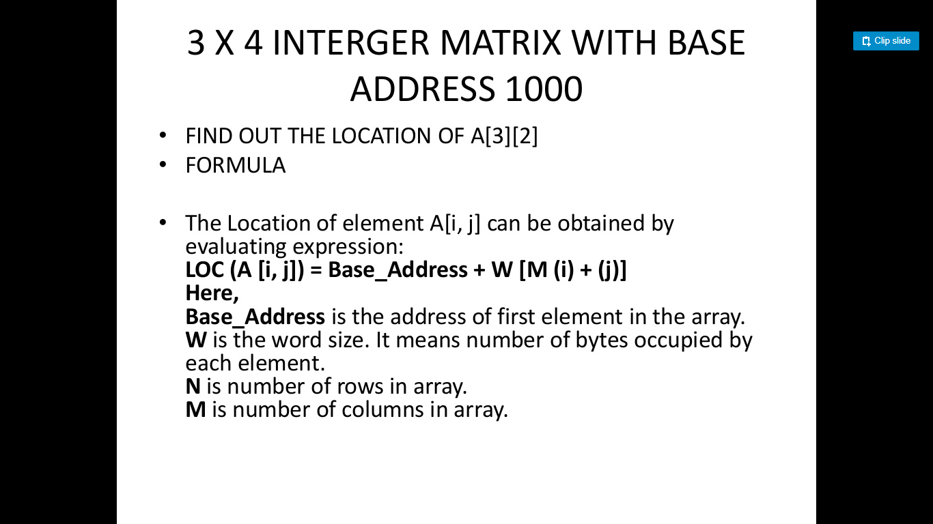
Two Dimensional Array: Problem
Given: 3×4 Integer matrix with base address 1000.
Find out the location of A[3][2].
Using Row major Formula

Slide 9
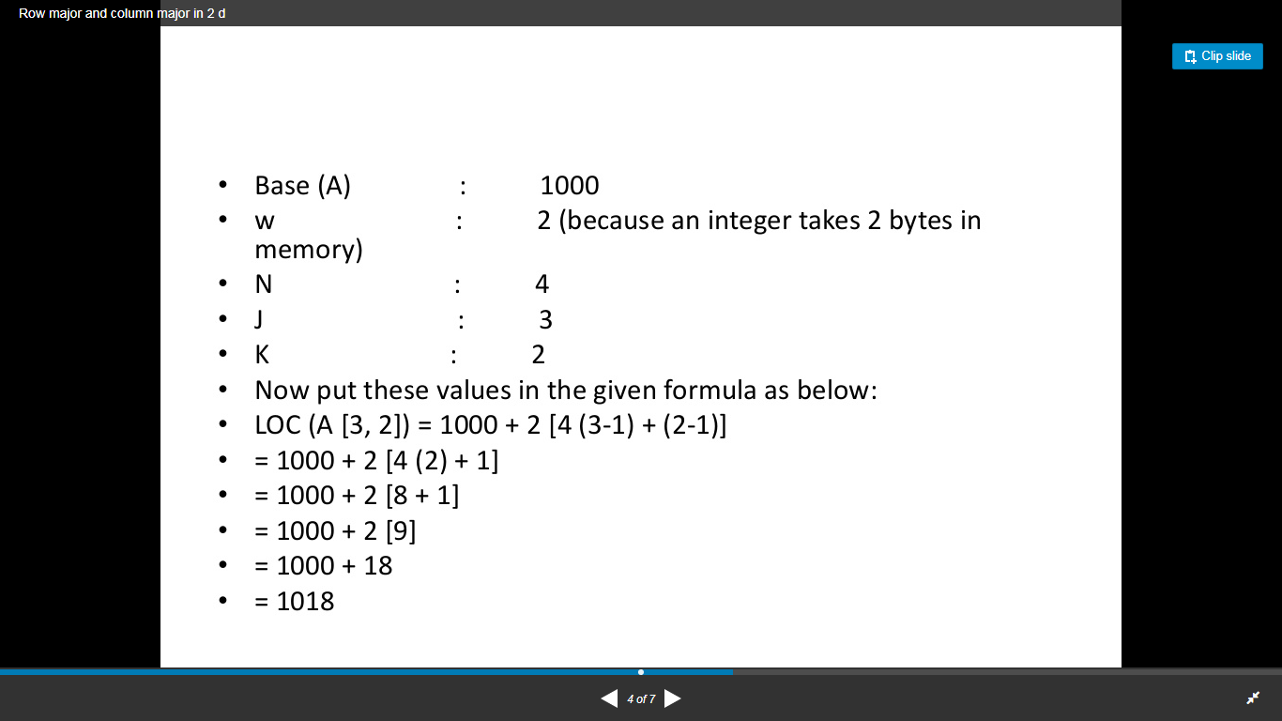
Two Dimensional Array: Problem
Given: 3×4 Integer matrix with base address 1000.
Find out the location of A[3][2].
Using Row major Formula

Slide 10
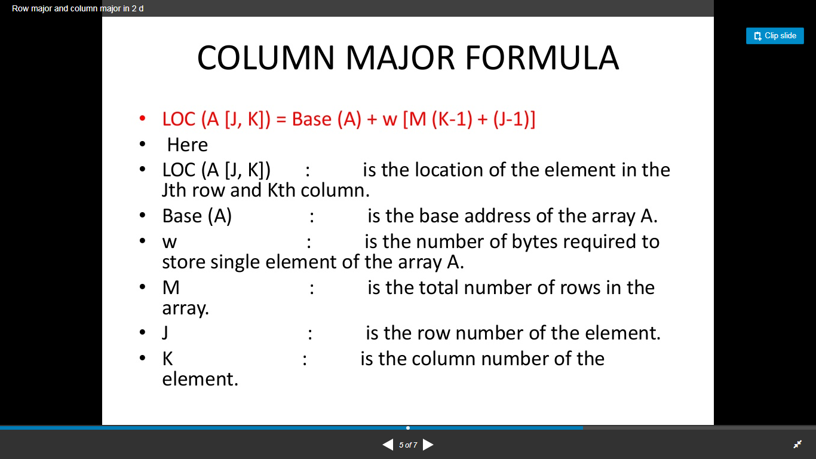
Two Dimensional Array: Problem
Given: 3×4 Integer matrix with base address 1000.
Find out the location of A[3][2].
Using Column major Formula

Slide 11
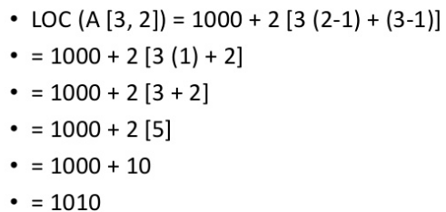
Two Dimensional Array: Problem
Given: 3×4 Integer matrix with base address 1000.
Find out the location of A[3][2].
Using Column major Formula

Slide 12
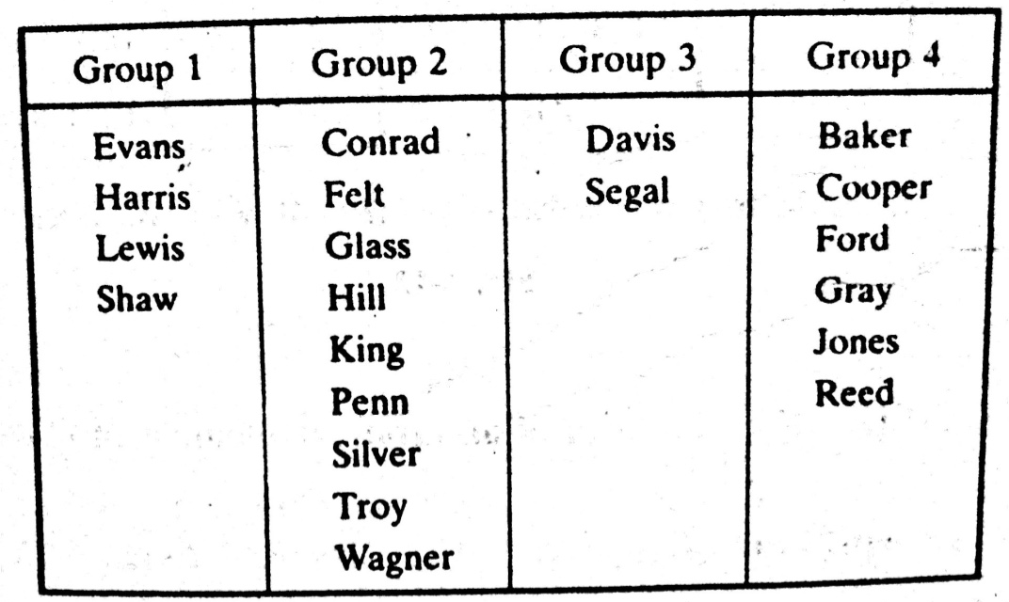
Pointers
Let DATA be any array. A variable P is called a pointer if P “points” to an element in DATA, i.e., if P contains the address of an element in DATA.
Pointer Arrays
An array PTR is called a pointer array if each element of PTR is a pointer
Pointer and Pointer array are used to facilitate the processing the information in DATA
How the membership list can be stored in memory keeping track of the different groups?
Notes:
Consider an organization which divides its membership list into four groups, where each group contains an alphabetized list of those member living in a certain area.

Slide 13

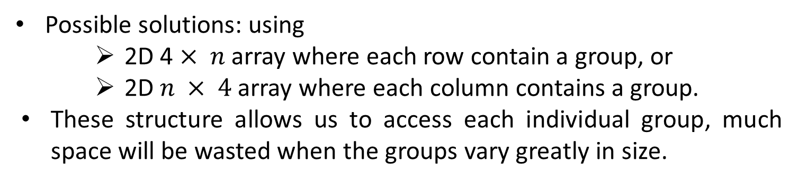
Possible Solutions to keep in memory
Possible solutions: using
    2D 4 $× n$ array where each row contain a group, or
    2D $n × 4$ array where each column contains a group.
    These structure allows us to access each individual group, much space will be wasted when the groups vary greatly in size.
Here the data will require at least a 36-element 4 x 9 or 9 x 4 arrays to store the 21 names, which is almost twice the space that is necessary.

Slide 14

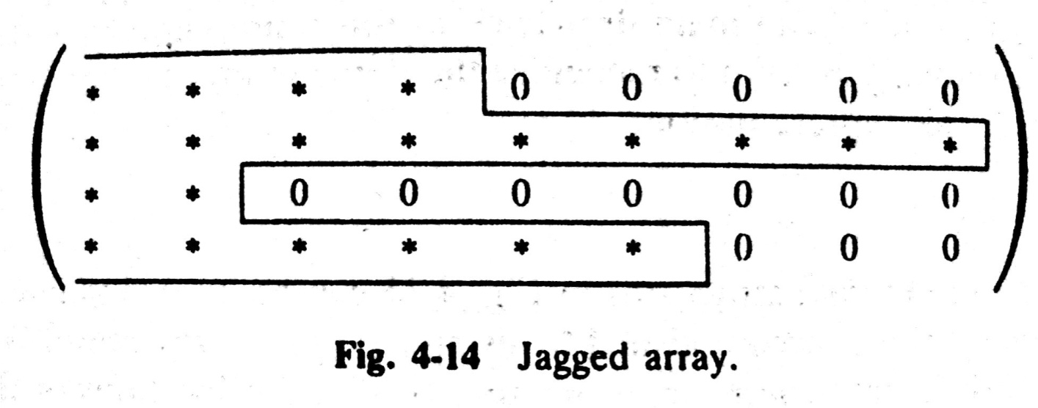
Representation of 4 x 9 array
Jagged array
Arrays whose rows –or column- begin with different numbers of data elements and each with unused storage locations are said to be jagged.

Slide 15


Possible Solutions to keep in memory
 | MEMBER
1 | Evans | Group-1
2 | Harris
3 | Lewis
4 | Shaw
5 | Conrad | Group-2
.
.
13 | Wagner
14 | Davis | Group-3
15 | Segal
16 | Baker | Group-4
.
.
20 | Jones
21 | Reed
Space-Efficient
Entire list can be easily processed
One can easily print all the names on the list.
One group after another
There is no way to access any particular group.
There is no way to find and print only the names in the third group.

Slide 16
Possible Solutions to keep in memory
 | MEMBER
1 | Evans | Group-1
2 | Harris
3 | Lewis
4 | Shaw
5 | $$$
6 | Conrad | Group-2
.
.
14 | Wagner
15 | $$$
16 | Davis | Group-3
17 | Segal
18 | $$$
19 | Baker | Group-4
.
.
20 | Jones
21 | Reed
25 | $$$
Uses only a few extra memory cells-one for each group.
Any one now find those names in he third group by locating those names which appear after the second sentinel
The list still must be traversed from the beginning in order to recognize the third group.
The different groups are not indexed with this representation.

Slide 17
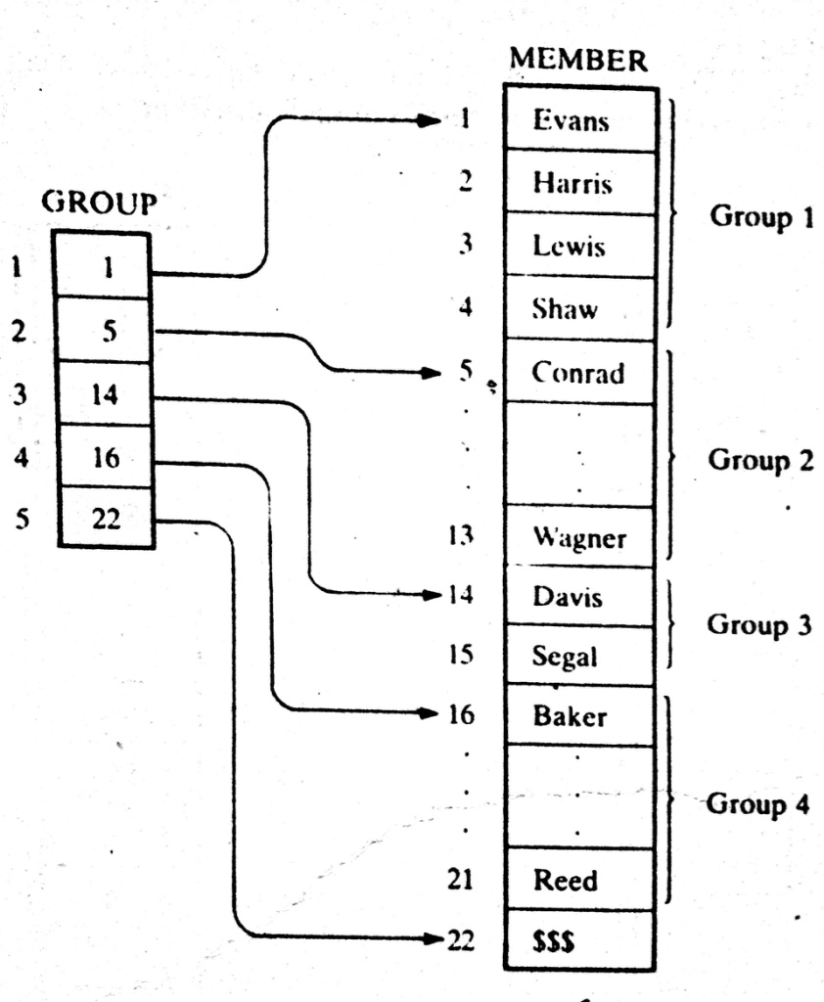

POINTER ARRAYS
Pointer arrays is introduced in the last two space-efficient data structure.
The pointer array contains the locations of the…..
  Different groups, or
  First element in the different groups.
  GROUP[L] and GROUP[L+1]-1 contain respectively, the first and last element in group L.
Suppose L=3
1st Element of grp 3?
GROUP[L]=GROUP[3]
= 14
= Davis
Last Element of grp 3?
Pls Try

Slide 18
POINTER ARRAYS: Example
Last element of grp 3
GROUP[L+1]-1
=GROUP[3+1]-1
=16-1
=15
= Segel

Slide 19
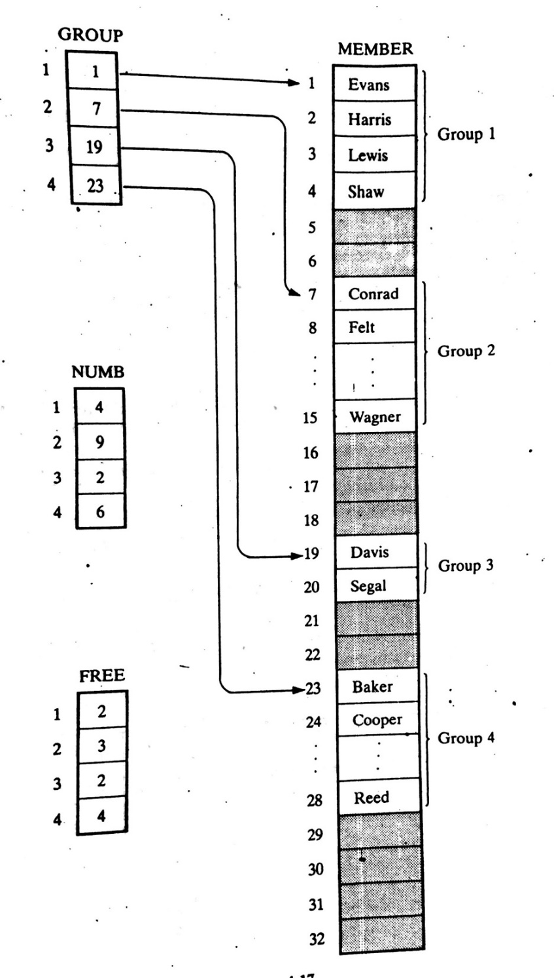
POINTER ARRAYS: Extended
Here unused memory cells are indicated by the shading.
Observe that now there are some empty cells between the groups.
Accordingly, a new element may be inserted in a new group without necessarily moving the elements in any other group.
Using the data structure, one requires an array NUMB which gives the number of elements in each group.
Observe that GROUP[K+1]-GROUP[K] is the total number of space available for group K. Hence
FREE[K]=GROUP[K+1]-GROUP[K]-NUMB[K]
Gives the number of empty cells following GROUP K

Slide 20
POINTER ARRAYS: Extended, Example
Suppose, we want to print only the number of FREE cells of GROUP 2. Then
FREE[K]=GROUP[K+1]-GROUP[K]-NUMB[K]
FREE[2]=GROUP[2+1]-GROUP[2]-NUMB[2]
= 19-7-9
=3
For GROUP 3?
Try now

Slide 21
RECORDS
A record is a collection of related data items, each of which is called a field or attribute, and
a file is a collection or similar records.
Although, a record is a collection of data items, it differs from a linear array in the following ways…............
    A record may be a collection of nonhomogeneous data;
    The data items in a record are indexed by attribute names, so there may not be a natural ordering of its elements.

Slide 22
RECORDS: Structure Example
Newborn
  2. Name
  2. Sex
  2. Birthday
    3. Month
    3. Day
    3. Year
    2. Father
    3. Name
    3. Age
    2. Mother
    3. Name
    3. Age
Under the relationship of group item to sub- item, the data items in a record form a hierarchical structure which can be described by mean of “Level” numbers
Name | Sex | Birthday |  |  | Father |  | Mother
 |  |  |  |  | Name | Age | Name | Age

Slide 23
Indexing Items in a Record
Suppose we want to access some data item in a record.
We can not simply write the data name of the item since the same may appear in different places in the record. For example…..
Newborn
  2. Name
  2. Sex
  2. Birthday
    3. Month
    3. Day
    3. Year
    2. Father
    3. Name
    3. Age
    2. Mother
    3. Name
    3. Age
In order to specify a particular item,
  we may have to qualify the name by using appropriate group item names in the structure.
  This qualification is indicated by using decimal points (periods) to separate group items from subitems.
  Example: Newborn.Father.Age or Father.Age
Fully qualified reference

Slide 24
Indexing Items in a Record
Newborn
  2. Name
  2. Sex
  2. Birthday
    3. Month
    3. Day
    3. Year
    2. Father
    3. Name
    3. Age
    2. Mother
    3. Name
    3. Age
Newborn(20)
  2. Name
  2. Sex
  2. Birthday
    3. Month
    3. Day
    3. Year
    2. Father
    3. Name
    3. Age
    2. Mother
    3. Name
    3. Age
Newborn is defined to be a file with 20 records
The Name of the sixth newborn to be referenced by writing …....
Newborn. Name[6]
The age of the father of the 6th newborn may be referenced by writing…..
Newborn.Father.Age[6]

Slide 25
Representation of RECORDS in memory
Since records may contain nonhomogeneous data, the element of a record can not be stored in an array.
See Example: 4.18, 4.20, 4.21

Slide 26
MATRICES and SPARSE MATRICES
Teach Yourself with example
Try to understand the SOLVED Problems

Slide 27
Thank you……

